Slide 1
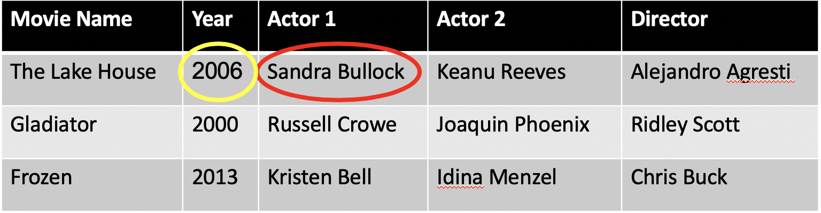
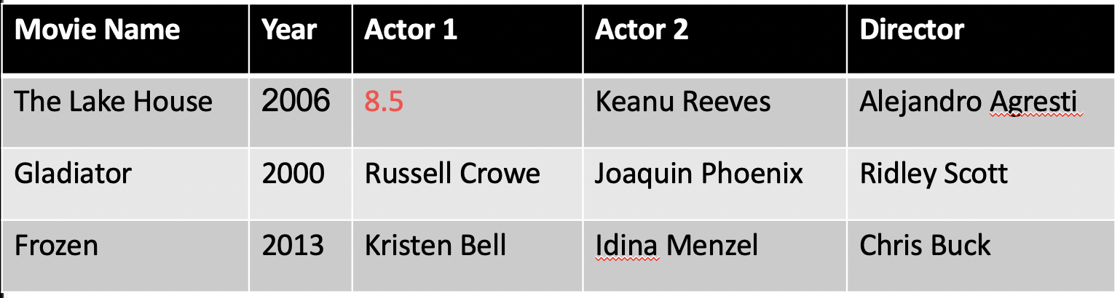
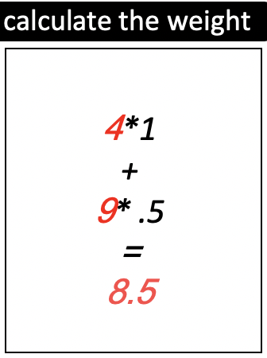
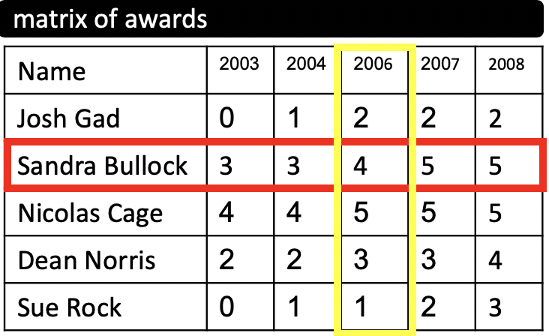
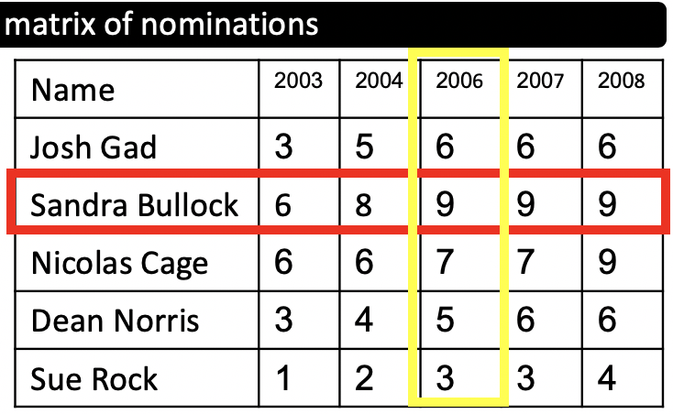

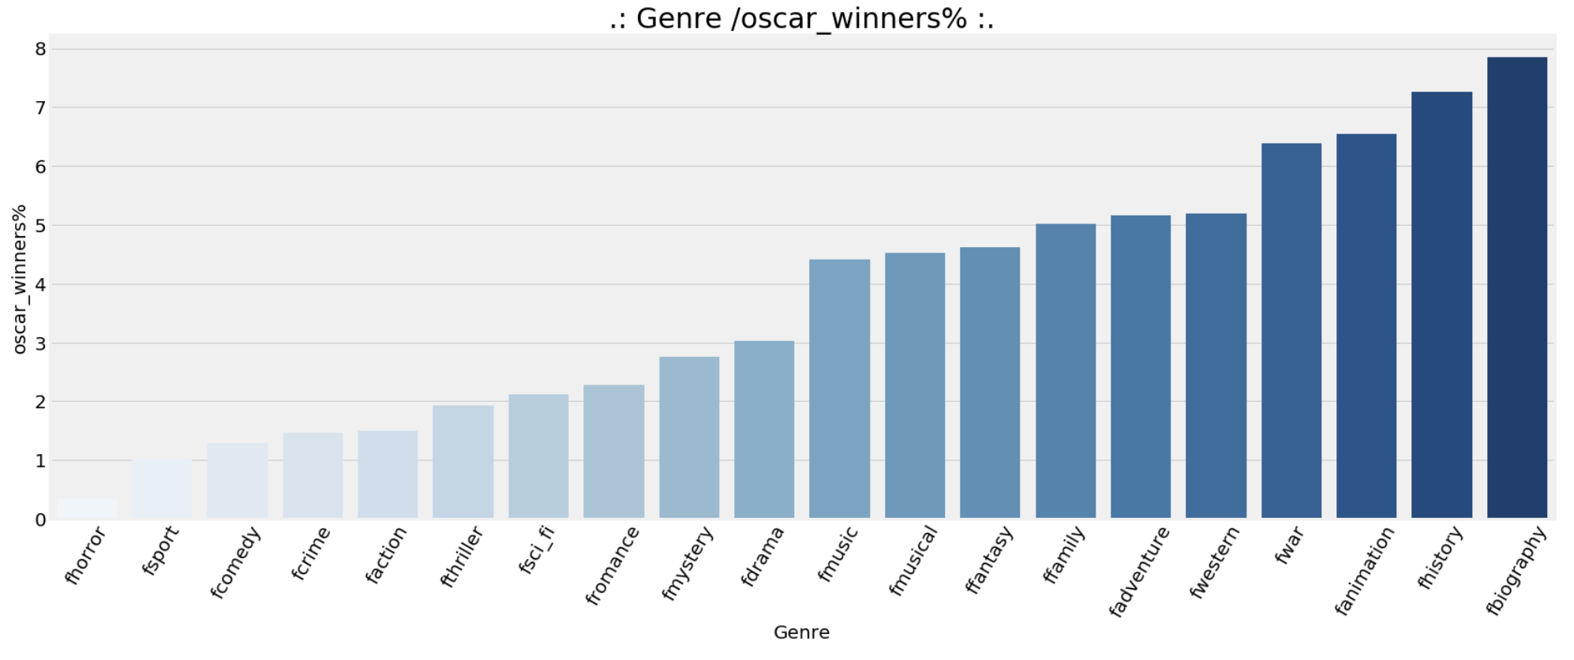
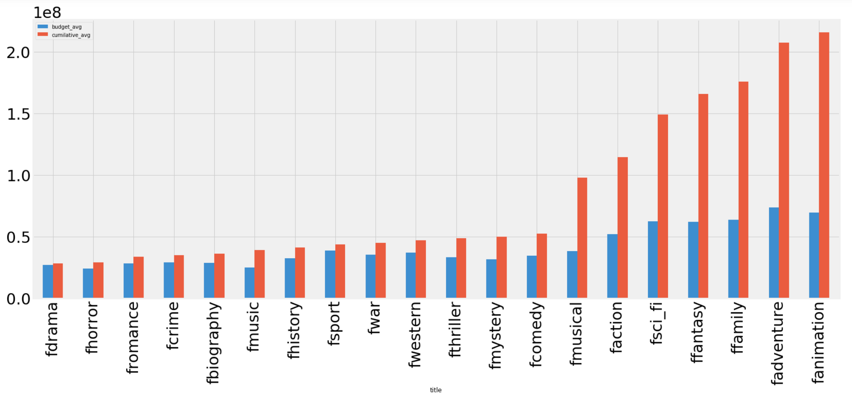
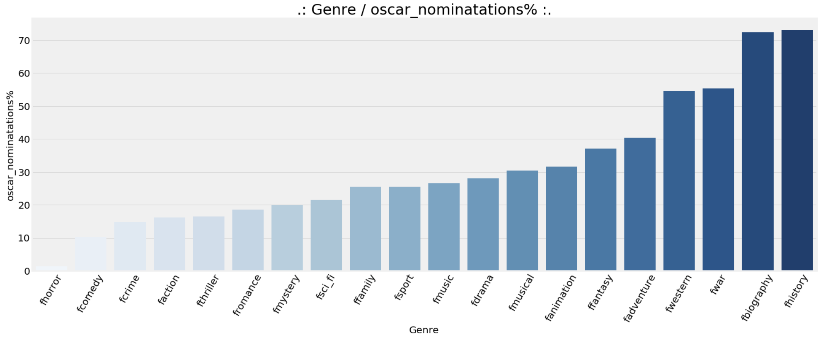
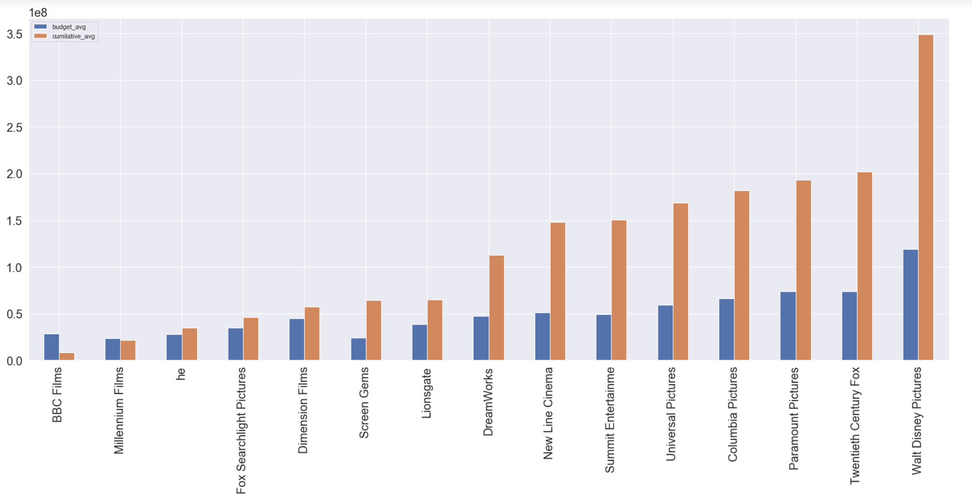




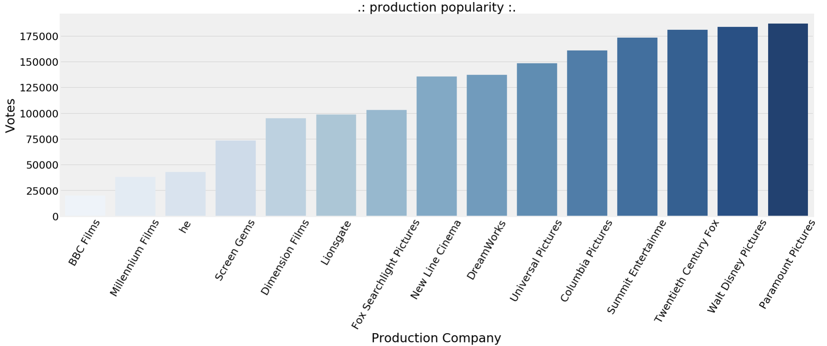
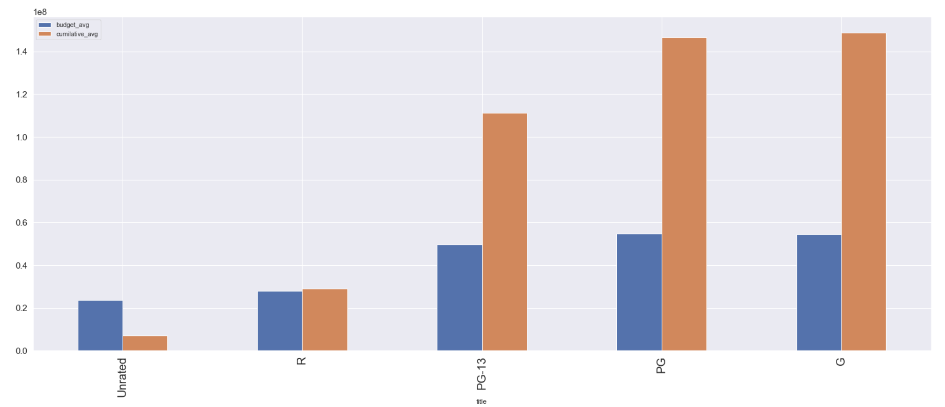
Movies Business Analysis
Bader Abanmi
Basmah Alabdullatif
ABSTRACT
Feature Engineering
The movie industry is one of the largest entertainment industries. It has been estimated that there are 500000 movies produced up to this point. Lately, Saudi Arabia is moving toward investing on entertainment. Therefore, giving the possibility that soon there will be a Saudi Production Film. In order to move on the right path of creating a blockbuster movie we will analyze what features contribute to a movie being successful.
Motivation:
Lifting the 35-year ban on cinemas is one of the most visible and impactful initiatives that has taken place in Saudi
“One of the QoL's metrics is to develop the local film industry with the goal of producing 13 Saudi movies by 2020” PWC
“The Saudi cinema industry has the potential to generate total revenue of USD 1.5 billion in 2030”
PWC
Objective:
What contributes to a movie’s success?
Is profit associated with movies achieving awards?
Is there a legit metric to winning the Oscar?
Replace the names of crew with representative weight that calculated as follows:
Country
[UK, CA]
Include US
Multi country
0
2
Data-science Pipeline
Expletory Data Analysis
Data Collection
Data Sources
Oscar winners Dataset
Actor Awards
Box-office
Data Collection Methodology:
we created a dataset of more than 10,000 movies produced between 2000 and 2017.
For each year we took the top 250 movies in terms of popularity, then we collected randomly 4% of the remaining movies to assure diversity in all respects.
After Analyzing many data sources, we realized that Some data sources such as (TMDB) is not a reference because any user can append false information about a movie therefore, we disregarded it
Data Cleaning
Modeling and Evaluation
Production company
Runtime
Certificates
Rating and Votes
Fill missing value with (other)
Predict using regression models
Fill with runtime average of the same genre
Fill with mode of the same genre
Fill with 0
Budget
Month
Choose randomly between top 3 months.
Year
Convert to Date-Time
Genre
Splited the genre into multiple columns to reduce redundancy
Finances
Removed symbols, calculated currency using Forex API
Certificate
Mapping the rating to the US rating system
Cast
Removing tags and fixing the format to get names
Predicting the movies revenue:
Highest features correlated with revenue:
Number of votes 0.74
Budget 0.61
Adventure genre 0.39
Best cross validation scores mean was: 74%
Using random forest regressor
Predicting Oscar winners.
Highest features correlated with wining:
Number of votes :: 0.4
Revenue :: 0.26
Audience rating :: 0.21
Best cross validation scores mean was: 98%
Using logistic regression
Precision :: 30%
Recall :: 20%
Conclusion
Number of votes is the highest positively correlated value with both revenue and Oscar winning.
We were able to predict a movie revenue with a score of %74.
Oscar winning prediction did not produce satisfactory results
In general history/biography/war has the highest chance of winning an Oscar
Acknowledgments
This project was the product of a 4 month intensive course offered by GA – Misk Academy
Special thanks to our mentors:
Dr. Junaid Qazi :: Course Lead
Dr. Ameen Mehablia :: Course Lead
Fatmah Aloqayli :: Instructor Assistant
Fahad Alsharekh :: Instructor Assistant
Future Work
Build a better model to better predict the revenue.
Build a better model to predict the Oscar.
Explore the actor award Dataset(Scraped)
Research reasoning about to explain our findings

